Slide 1
New Mexico
Farm Bill Roll Out
New Mexico Programs Staff

Slide 2
State Technical Committee/Farm Bill Roll Out Meeting April 22, 2020 10:00 am
Introductions........................................................... Kenneth Branch
State Conservationist .............................................. Xavier Montoya
Farm Service Agency……………………………………………. Mike White
Programs FB Roll Out................................................Kenneth Branch
  Environmental Quality Incentives Program (EQIP)- Kenneth/Ana
  CD/CART- Ana Gomes
  Agricultural Conservation Easement Program(ACEP)- Athena Cholas
  Conservation Stewardship Program (CSP)- Athena Cholas
  Conservation Innovation Grants (CIG)- Athena Cholas
Regional Conservationist Partnership Program (RCPP).. Kris Graham Chavez
Conservation Reserve Program CRP...........................Steve Kadas/Joilynn Gray
Partner Updates
State Forestry
Others
Questions

Slide 3
Chief Lohr’s Priorities
Implement and deliver the 2018 Farm Bill to our nation’s farmers, ranchers, and private foresters.
Streamline our processes and program delivery to best serve our customers.
Better understand our customer needs and improve overall customer service.
Increase internal mentoring, training opportunities, and experiences that collectively involve staff, customers and partners.
Expand focused outreach efforts to increase agency awareness among populations of Beginning Farmers & Ranchers, Historically Underserved, Veterans and Women farmers and ranchers to better help their conservation successes.
Elevate the importance of soil health across our agency outreach and communications efforts to further enhance and promote the delivery of soil health principles to staff, customers and partners.

Slide 4

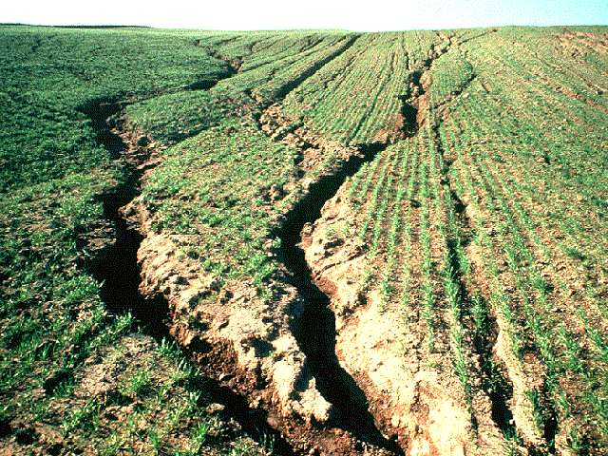
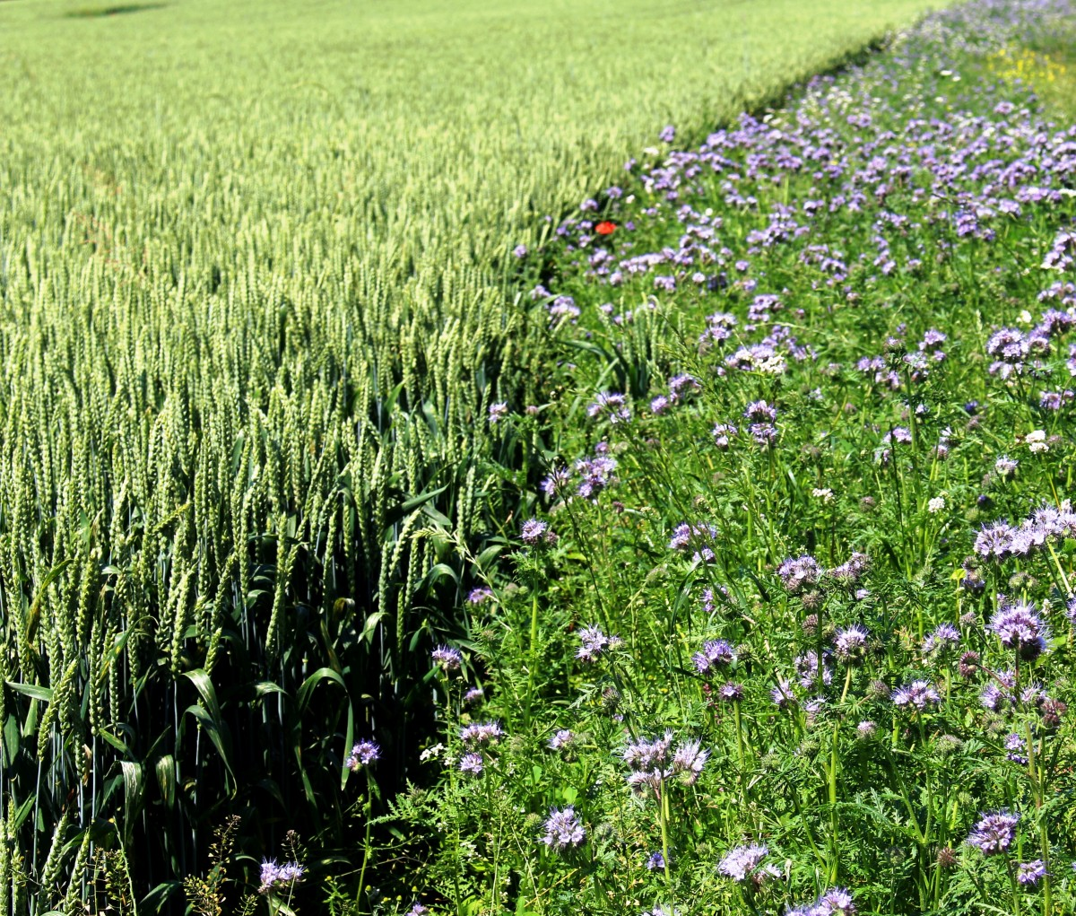
Planning
  Determine the conservation treatment needed to improve an identified RC which meets producer objectives
  Identifying the conservation practices or Activities
  Consider the practice or activity lifespan
Notes:
Subpart D provides policy related to planning, screening, assessing, ranking and determining application eligibility. This section includes those policies that are common across FAP.
Any program-specific planning, screening, assessment, ranking or eligibility requirements will be found in the respective program subparts: Subpart P for AMA, Subpart Q for CSP, and Subpart R for EQIP.
Note: Subpart D begins with planning as conservation planning is the cornerstone of what we do as an agency, and typically begins once a producer requests assistance either for technical help, or, to apply for a conservation program.

Slide 5
Policy Changes
2018 Farm Bill requires streamlined and coordinated procedures
Regulations modified to simplify language to improve clarity, organization, readability, and reduce duplicative information
Policy manual “overhaul” to address 2018 FB changes and align with the new business process
Four manuals combined into one manual (530) in order to streamline, simplify, and align program policies:
  Part 512 – Contracting
  Part 515—EQIP
  Part 507—CSP
  Part 521—AMA
Notes:
Why did we take such a drastic approach to update the policy for this Farm Bill? Why did we created a new manual? The 2018 Farm Bill requires streamlined and coordinated procedures. There is specific language in the Farm Bill to streamline and coordinate EQIP and CSP. There is also similar language to simplify the RCPP application process.

Slide 6
Changes in FB 2018
If Effect in FY 2019
Control of Land at the time of application
NRCS verifies that control is maintained prior to contract obligation, during annual contract reviews, and prior to approval of any payments
Signature Authority for Legal Entities
Established at the time Form CCC-901, “Members Information,” or Form CCC-902, “Farm Operating Plan
Notes:
Goal: Clarify and Simplify application requirements
Moved information from Circular 440 19-1 into new manual: COL, dependent practices, signature authorities for entities, payments when participant has died.
Purpose. To communicate policy changes related to control of land, signature authority for entities, payments for practices that are part of a conservation system also referred to as “dependent practices,” and payments when a participant has died.
Out of these changes, we produced a new landowner concurrence form NRCS-CPA-1257
Reference Exhibits for landowner concurrence form

Slide 7
Continued
Landowner concurrence form to install practices
Prior to obligation, tenants must obtain and provide to NRCS written concurrence from the landowner to apply a structural or vegetative conservation practice or activity.
  NRCS-CPA-1257
  Coordinated Resource Mgnt Plan (CRMP)
  State Land Approved Application for Improvement
Dependent Practices
NRCS may make incremental payments when each completed unit independently meets the NRCS standards and specifications.

Slide 8

Continued
Historically underserved and Veteran applicants –
  Eligible for increased payment rate
  Advance payment
Veteran Preference –
  New Veteran Definition includes veterans who have been discharged in most recent 10-year period
  Veteran’s preference in BFR or SDFR ranking pools
  VFR evaluated in other ranking pools:
    may receive higher payment rate
    may elect to receive AP
    Are not provided preference points
Notes:
Definitions for HUP are found in 440-CPM 502 “Terms and Abbreviations Common to all Programs”. The 502 manual is being updated concurrently with the development of 530, and is referred to extensively throughout 530.
Veterans may qualify as a VFR without being a BFR if discharged within the most recent 10-year period
Veterans preference is now given as points, whereas in previous FB’s, eligible VFR’s were provided high priority for ranking

Slide 9
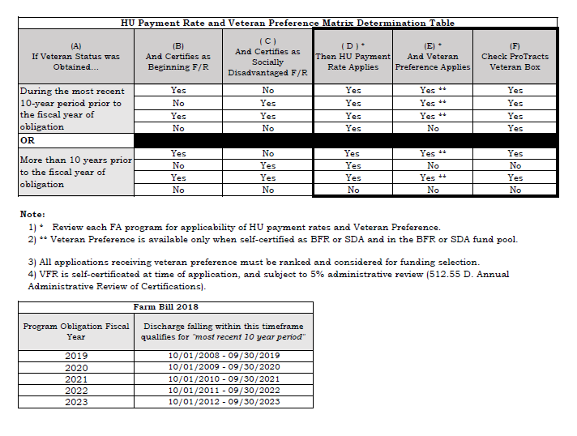
NB 300-19-20 LTP
VETERAN MATRIX-
Notes:
National Bulletin 300-19-20 LTP Shows this Matrix- Veteran Preference Matrix Determination Table
guides you with questions of VFR Status, and obligation year, “during the most recent 10 year period prior to FY of obligation, or More than 10 years prior to FY of bligation)

Slide 10
Request for Assistance
Application for Assistance
Request for assistance can be verbal
  Though policy allows for verbal request, a CCC 1200- Program application is still required
    Staff will take information over the phone
    CCC 1200 will be signed next time producer is in the office
Notes:
Request for assistance can be verbal; doesn’t need a CPA-1200
Only need application at ranking
Also explain when a signed application must be received (before ranking to ensure correct ranking pool.)
Discuss who is an agricultural producer,
who can be a potential applicant
explain new water management entity definition and eligibility

Slide 11
Application Processing- Ranking Tool
Conversation Assessment Ranking Tool (CART)
Assessment:
First part of CART
Assess Current Condition/Base Line and Existing Conservation Practices
CPA-1200 Application for Assistance is not required to complete an assessment
Ranking:
Ranking Questions and points associated with each fund pool
Applicant-submitted NRCS-CPA-1200 is required at ranking
Notes:
The assessment will look at the existing conditions and the additional activities and practices that the producer is considering.
A CPA-1200 “Conservation Program Application” is not required for the assessment. However, a CPA-1200 application is required at ranking.
Note: Do not use old Farm Bill application forms. FB18 application will be updated, but for now do not check box 10 as it is irrelevant, and we are not required to provide the appendix at application. All appendices are being updated with new farm bill provisions.
As with AERT, states must save the ranking lists used for funding selections for each fund pool. Some refer to these as the “frozen lists.”
The New 440-CPM Part 530 manual refers to the CART handbook for Assessment and Ranking information, but this has not yet been developed. CART currently has a help icon
Note: The CART team has breakout sessions to fully explain how assessment and ranking will occur using business tools.

Slide 12
Contract Development and Requirements
Application Preapproval -
Intent to Proceed letter:
  Notifies producer of selection
  Confirms producer interest, and provides an estimated contract amount,
  Conservation Program Application Checklist confirms eligibility status, and any missing documents
Replaces the pending and preapproval letters
In NM Could help other agencies set priorities
Notes:
Once an application is set to preapproval, the “Intent to Proceed letter” notifies applicant of the completed assessment and evaluation and determination that the application meets priorities established for at least one ranking pool and may receive funding.
Along with the intent to proceed letter the, “Conservation Program Application Checklist,” an eligibility checklist, is sent to the applicant. This is provides the applicant an opportunity to finalize their eligibility and to provide any other documentation needed for contract development.
The intent to proceed letter replaces the “preapproval "and ”pending” letters.
If the applicant fails to respond or provide required information by the date requested, NRCS may determine the application ineligible.
Vendor codes are established for each participant receiving a payment share. Must be completed before application can be set to “approved” status.
Note: even though eligibility is not required until application approval, producers may submit documents and update certifications at any prior stage in the planning and application process.

Slide 13
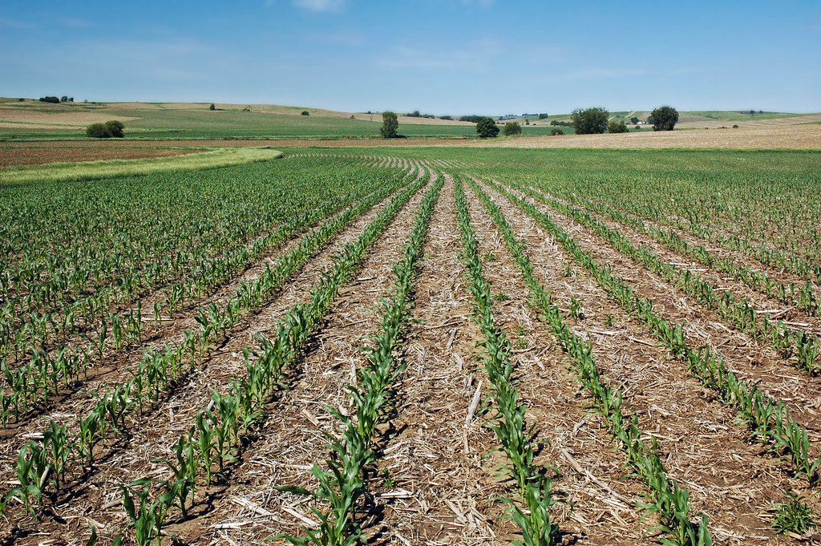
2018 Farm Bill Training
Environmental Quality Incentives Program
New Mexico
Ana Gomes
Kenneth Branch
Policy in this presentation is DRAFT and subject to change
Notes:
Noticed Kenneth yesterday went through Subparts-C through D of the 530 manual, Chad went through E, F, G, Penny (H and I).

Slide 14
Funds Management
Funding Targets and Ranking Pools –
  Wildlife target increased from 5% to 10%
    States may create wildlife habitat-focused ranking pool
    Joint Chiefs, Longleaf, WLFW-LCI, Core wildlife practices
  Livestock target decreased from 60% to 50%
  At least10% of funds under the conservation title reserved for Source Water Protection
Notes:
Here is the list of targets for EQIP. They are counted at the national level, but states need to be aware of them to ensure we meet these targets as an agency
The 2018 Farm Bill requires that NRCS dedicate financial assistance dollars in the following categories:
Livestock – 50%
Source Water Protection – 10%
Wildlife – 10%
Socially Disadvantaged Farmers or Ranchers – 5%
Beginning Farmers or Ranchers – 5%
Note: CRP and AMA are not included under the 10% for SWP since they are not under title II, conservation programs
States should use the from provided in NI 306.12 “Guidance for Implementing EQIP and AMA” form to report how funds will be used for wildlife. A training was provided under an FAP monthly teleconference last FY.
SWP does that the 10% funding is cumulative across conservation programs.

Slide 15

EQIP Eligibility
Irrigation History Requirements –
  Consolidated irrigation history waiver requirements into exhibit 530.420 C, “Irrigation History Waiver Checklist”
  Field staff need to ensure the form is completed by producer
Documenting Land Eligibility–
  Moved the ProTracts list of Ag products and commodities and livestock types (Beef to RATITES) to Part 502
  Grouped the examples of livestock production under general categories
Notes:
515.52 Land Eligibility has extensive lists for ag products and commodities from Barley to Vegetable to Other Crops as identified by the STC, and
An extensive list of what is considered livestock, from Beef to Ratites and Other Livestock as identified by the STC
CPM 440 Part 502 is the “Common Terms and Provisions Common Across FAP” manual

Slide 16
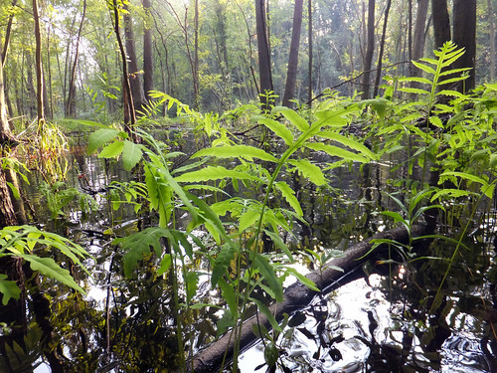
EQIP Eligibility
Adjusted Gross Income Waivers
Pending publication of 7 CFR Part 1400 or, Departmental Delegation Regulation
Waiver authority will be delegated to the Chief
    For projects that will result in the ‘protection of environmentally sensitive land of special significance
    ACEP, AMA, CIG, CSP, EQIP
Notes:
We anticipate 7 CFR Part 1400 to be published in January-ish timeframe.
FAPD and EPD are coordinating development of one unified and streamlined process to include a standardized AGI waiver worksheet for processing requests and documenting decisions.
The new worksheet is similar to the worksheets used under the 2008 Farm Bill, but simplified.

Slide 17
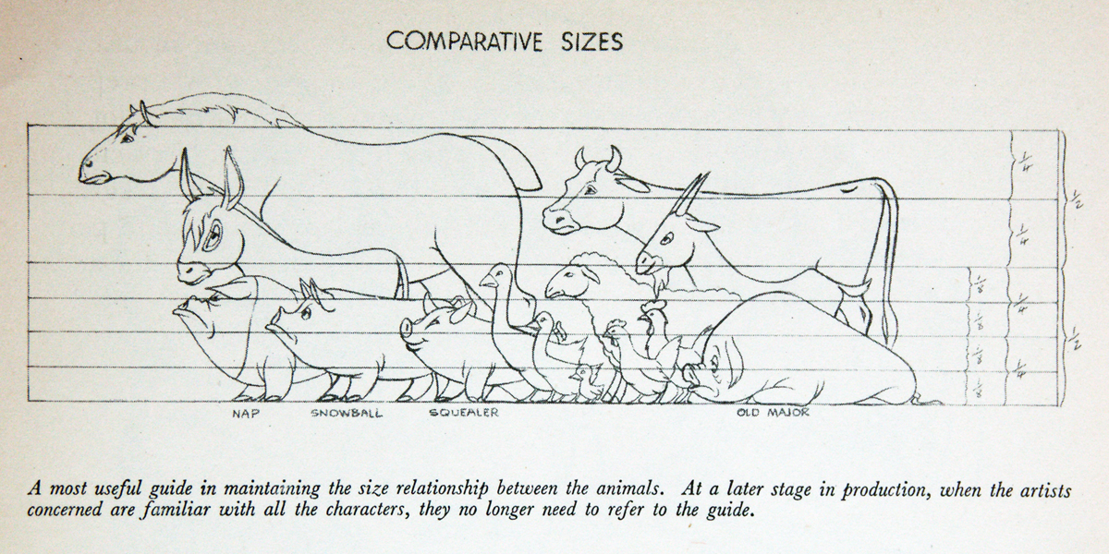
EQIP Planning
Changes in land use or land management system–
  Updated terminology to align with CSP
Animal feeding operations–
  Additional Criteria was Added to expand operation of an AFO or relocating an AFO to require a site-specific EA or EIS
PROGRESSIVE PLANNING
ALLOWED FOR CNMP’s
Notes:
Removed term “production system” and replaced with land Management System which is consistent with CSP.
Additional criteria was added to expanding operation since expanding an AFO is not covered by any of NRCS’ categorical exclusions, nor are the impacts of expanding an AFO adequately analyzed in the programmatic EA for EQIP.
Additional Criteria was Added an additional criteria for expanding or relocating an AFO to require a site-specific EA or EIS

Slide 18
EQIP Contracting and Contract Management
  The EQIP Plan of Operations is used to record HUP decision to receive / not receive an AP, per CIN
  Contract terms may be extended for certain projects to ensure establishment and function:
    Wildlife habitat
    Long lifespan
  2018 FB allows progressive implementation of CNMP’s if:
    Implemented practices are operable and function
    Participant follows a nutrient management plan
    Practices in the system must meet the planning criteria
Notes:
The 1155 and 1156 will be used to record the HU applicant’s decision to receive or not receive an AP. Applicants can changes their mind, and we will process the 1245 as requested.
Contract terms cannot exceed EQIP statutory limits of 10 years.
EQIP now allows certain wildlife habitat projects to have terms up to 10 years for management practices.
New policy allows certain projects with long lifespans to have terms of up to 10 years to ensure continued O&M and successful utilization of the practices

Slide 19
Application Processing
Disaster Assistance—
  Provides STC’s authority to waive 30-day sign up period, announcement, and request for payment schedule items
  An SOP is under development to provide procedural guidance for states’ to request funds, disaster reports, urgency, etc.
ACT Now (aka, Fast Pass)—is under development:
  Will allow states to fast track applications based on certain criteria, and
  This is a customer service improvement
Notes:
Just a heads up that we have a couple of placeholders in the 530 manual for new policies related to disaster assistance and to expediting funding decisions in certain situations.
The Implementation Team is currently developing an SOP for Disaster assistance including criteria for STC’s to be able to approve some of the common disaster-related policy waivers.
Act Now is also under development and is a response to a Departmental request to find a way to shorten the time between requests for assistance and funding. This is a customer service improvement

Slide 20
Advance Payments
  Advance Payments—Farm Bill18:
    Authorizes 50% of practice payment to HU Producers for materials or services
    NRCS must notify HUP of AP availability
    NRCS must document AP election on a CIN basis
    AP funds must be expended within 90 days of receipt
    AP practices must be completed as scheduled in plan of operation
Notes:
Currently, AP is set at 50%, but NHQ may provide for higher rates later in the FY or FY2021
States should complete an AP status review to confirm funds have been expended—additional reports will be available to help states track and monitor AP
If funds are not expended within 90 days of receipt, the producer must return the funds within a reasonable timeframe as determined by the STC
States should use reasonable consideration when determining expenditure of funds. Keep in mind that we should not be tracking expenditures or counting pennies.
Receipts or invoices are not required to document the expenditure of funds

Slide 21
Advance Payment - Notification
Per FB 2018, Historically Underserved (HU) applicants must be notified that they may receive advance payments.
Users must document the applicant’s intent to request an advance payment.
The applicant’s decision is selected in the ProTracts Application
This ONLY applies to EQIP 2018 and RCPP-EQIP 2014.
Notes:
The main points here are that HUP must be notified that they may request AP for contracted practices, and that NRCS must document the producer’s decision.

Slide 22
Advance Payment - Application
The applicant must have a HU category selected under the Applicant Information screen.
HU refers to:
  Limited Resource Farmer/Rancher
  Beginning Farmer/Rancher
  Socially Disadvantaged Farmer/Rancher
  Veteran Farmer/Rancher
Notes:
Note: The applicant must have at least one HU category selected under the Participant Information screen for the “Advance Payment Requested” check box to become active.

Slide 23
Advance Payment – 1245 Form
“ADVANCE PAYMENT: I understand that I am receiving advance payment(s) for the following and I hereby certify that I will complete the practice(s) by the agreed-to date(s) on the Conservation Plan or Schedule of Operations (NRCS-CPA-1155 or NRCS-CPA-1156), otherwise I will be responsible for returning payment(s) already received. Additionally, I understand that failure to expend the advance payment(s) within 90 days of receipt of the funds is a violation of the contract.”
Notes:
The AP certification & payment process has not changed, but there is language change:
Language change is located in Section “2. Participant Certification and Signature “ of the NRCS-CPA-1245.

Slide 24


Advance Payment (Funds not expend)
  Field Office works with State Office to created bill
  The participant has 30 days to make payment; at day 30 the debt becomes delinquent.
  If the debt remains unpaid at day 60, NFC will issue a Past Due Notice; then a Final Debt Notice is sent at day 90.
  IF the debt remains unpaid at day 120 it is referred to Treasury.
  Treasury will begin penalties & interest and
  ADD a 28% administrative fee.
Notes:
Meanwhile…. Back at the Ranch….
This is provided to let you know that the participant must take this federal debt seriously.
This is TIME SENSITIVE!
The participant is under the gun to pay the funds back.

Slide 25
EQIP Payments and Payment Limitations
  The maximum EQIP payment percentages allowed for each cost category are provided in Figure 530-R1:
Authorized Cost Categories and Maximum Payment Percentages
Cost Category | General Percentage | HU Percentage | High Priority Practice | Source Water Protection
Materials | 75% | 90% | 90% | 90%
Equipment for Installation | 75% | 90% | 90% | 90%
Labor | 75% | 90% | 90% | 90%
Mobilization | 75% | 90% | 90% | 90%
Acquisition of Technical Knowledge | 75% | 90% | 90% | 90%
Income Forgone | 100% | 100% | 100% | 100%
Notes:
New categories in yellow include HPP and SWP

Slide 26
EQIP Payments and Payment Limitations
  FB 2018 Payment limitations:
    Aggregate payments cannot exceed $450K
    Payment limitation is not cumulative with prior FB’s
    Organic payment limitation (NOI) increased from $80K to $140K with no annual payment limitation
  Contract limitations:
    $450K contract limit with a person or legal entity
    New: Joint operations and group projects may be eligible for $900K contract limit
Notes:
For FB 2018, payment limitations does not include any unexpended funds from prior farm bill contracts
The $20K annual payment limitation for NOI contracts has been removed and payment limit increased
Joint operations include FSA business type codes 2 and 3

Slide 27
EQIP Payments and Payment Limitations
  Contract Transfers:
    From person or legal entity to a joint operation - No increase
    From joint operation to an individual or entity - Contract limit decrease
Notes:
Information on payment limitations for transferred contracts has been clarified

Slide 28
  High priority practice (HPP)–
  2018 Farm Bill authorized increased payment for up to 10 high priority practices
  Criteria to follow when selecting HPP
    Address water quality impairment due to excess nutrients
    Address water conservation,
    Meet other identified priority RC’s in habitat or other area restoration plans, or
    Are geographically targeted to a specific watershed
Notes:
The new HPP Water quality criteria includes ground- or surface-water impairments
Water conservation includes declining aquifers and drought mitigation
And, other environmental priorities

Slide 29
2020 HPP in NM
NM has taken the appropriate actins outlined in the EQIP
interim rule and national bulletins to identify the High Priority
Practices
1. Cover Crop- Multispecies Scenario Only- 340
2. Diversion-All Scenarios-362
3. Grade Stabilization-All Scenarios-410
4. Residue and Tillage Management, No Till- All Scenarios-329
5. Residue and Tillage Management, Reduced or Mulch Till-345
6. Structures for Wildlife-All Scenarios-649
7. Upland Wildlife Habitat Management-All Scenarios-645
8. Wildlife Habitat Planting-All Scenarios-420

Slide 30
Water Management Entities – (WME’s)
  New term to describe “certain entities” under the new Water Conservation and Irrigation Efficiency provision
  Means a state irrigation district, groundwater management district, acequia, land grant, or similar entity that has jurisdiction or responsibilities related to water delivery or management to eligible lands
Notes:
EQIP regulation introduces a new term, Water management entities which is a collective term for the groups listed on this slide.
These public or semi-public agency or organization may enter into an EQIP contract if they serve a public purpose such as a utility, with the purpose of assisting private ag producers with managing water distribution systems.
FSA has added business type code 9 “State / Local Government” in business partner and you will find it on the updated eligibility matrices for EQIP. Again, these public or semi-public agencies are eligible only under water conservation or irrigation efficiency projects.
Note: FSA makes business type code determinations based on the information the applicant provides to FSA

Slide 31
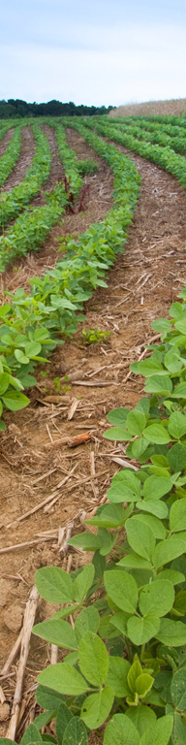
15 November 2019
§ 1466.6 Program Requirements
Expanded eligibility regarding with whom NRCS can enter into an EQIP contract.
  NRCS may enter into EQIP contracts with a State, irrigation district, groundwater management district, acequia, land grant–merced, or similar entity. NRCS has defined these entities as “water management entities.” if
    the water management entity is a public or semi-public agency or organization (meaning a private or public company that serves a public purpose such as a public utility
    the water management entity purpose is to assist private agricultural producers with managing water distribution systems
Notes:
Section 1466.6 lays out the general scope of what EQIP is and does.
Sets forth criteria for applicant eligibility, including that the applicant must have control of the land on which EQIP practices are to be implemented.

Slide 32
WMEs- Water Conservation Projects
WME’s may request assistance on a watershed-wide water conservation project.
NRCS may approve entering into an EQIP contract with a water management entity when such contract is pursuant to a watershed-wide project of the water management entity that effectively conserves water using the following criteria:
  The project has a current, comprehensive water resource assessment
  The project plan incorporates one or more of the following practices:
    Water conservation scheduling and if applicable, distribution efficiency, soil moisture monitoring;
    Irrigation-related structural or other measures that conserve surface or ground water, including aquifer recover practices; or
    A transition to water-conserving crops, water-conserving crop rotations, or deficit irrigation.
  The project sponsors have consulted relevant State and local agencies.

Slide 33
WME’s Review
Applications from a water management entity for an EQIP contract will be determined ineligible if the State conservationist (or designee) determines that the conservation practices encompassed by the proposed EQIP contract are better suited for implementation under the RCPP or 7 CFR Part 622, “Watershed Projects.” In making this determination, the State conservationist may consider the following factors:
  The estimated contract cost for the minimum area required for the EQIP contract greatly exceeds the EQIP payment limitation for water conservation projects.
  Potential adverse impacts from the water management entity’s watershed-wide project have not been adequately analyzed under a National Environmental Policy Act (NEPA) review, or the proposed contract practices have not been adequately analyzed in the EQIP Programmatic EA or other existing NEPA document prepared or adopted by NRCS and requires a site-specific EA or EIS.

Slide 34

FSA Eligibility and Maps
FSA makes business type code determinations
State or local government (Business Code 9)
AGI not required (no CCC 941)
LLC or other entity
CCC 902 (901 if applicable), AD 1026
CCC 941 down to warm bodies with ownership interest greater than 0
Signature Authority (FSA COF may require)
ID, file a signature with the COF, supporting documents
Documents include:
  Meeting minutes
  By laws giving authority
  And FSA-211
Eligible Land- Records Establishment is still under review by NHQ (FSA and NRCS)
NRCS Policy State “Land that is under control of the WME”

Slide 35
EQIP Payments and Payment Limitations
  Payment Limitation Waivers for WME’s:
    Water management entities may be eligible for AGI or PL waiver of up to 900K for water conservation projects based on:
      Number of producers who will benefit
      Conservation value
      Non-federal assets
      Extent of progressive practice implementation
      Other criteria determined by the Chief
    AGI waiver will be approved concurrently with PL waiver
Notes:
Water management entities – are a state irrigation district, groundwater management district, acequia, land grant—merced, or similar entity that has jurisdiction or responsibilities related to water delivery or management of eligible lands.
Note: waivers are applicable only to eligible water management entities applying with a water conservation and irrigation efficiency projects and not to individual producers,

Slide 36

EQIP
Incentive Contracts
New Mexico
Ana Gomes
440-CPM, Part 530, Subpart R - EQIP
Notes:
Policy and how to implement incentive contracts is still under development; however, we’ll talk about the direction under this provision.
This is also in Subpart D (Changes to these Subparts ) it is a new subpart and addresses the new enrollment option, EQIP incentive contracts, as created by section 2304 of the 2018 Farm Bill.

Slide 37
BRIDGE TO CSP
EQIP Incentive Contracts
  Expands resource benefits for producers and acts as a stepping stone to CSP.
  High priority areas have identified PRC’s:
    Must encompass every region within the State
    May cover whole state or, overlap with other HP areas
  Priority resource concerns (PRC):
    States ID up to 3 for each land use within a high priority area
    The same PRC may be used for multiple land uses within a high priority area
Notes:
The purpose of EQIP IC is to expand resource benefits for producers
EQIP IC can also act as a bridge to CSP
PRC’s are Priority Resource Concerns, and they represent a significant concern in a state or region

Slide 38
Incentive Contract Period
NUANCES OF CSP
  Incentive contracts will be for a period from 5 to 10 years. (Mandatory)
  Specifies that NRCS shall apply ‘science-based’ criteria to determine an appropriate contract period to achieve the desired conservation benefits.
  Most notable distinctions between standard EQIP contracts; are differences to the contract period and payment rates. (Mandatory)

Slide 39
EQIP Incentive Contracts
  Payments are made of two components:
  Incentive practice payments for adopting and installing practices
  Annual payments for managing, maintaining, and improving incentive practices during the contract period
  Aggregate payment limitation:
  May not exceed $200k total payments to person or legal entity
  PL may not be waived
Notes:
Payments for EQIP IC may have an incentive practice payment and an annual payment
The Payment limitation is based on direct or indirect payments received under all incentive contracts during the 2018 Farm Bill

Slide 40
High Priority Practices-
EQIP Incentive
HPP’s Planned in EQIP Incentive areas will get the high payment
May be the same as Source Water Protection Practices as long as the HPP’s meet the SWP criteria
Notes:
States may offer increased incentives and up to 90% payment rates within the identified priority area- For up to 10 practices

Slide 41
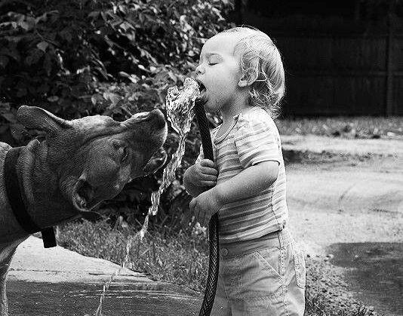
Source Water Protection
NRCS National Training
December 9-13, 2019
New Mexico
Ana Gomes

Slide 42
Source Water Protection Language in the 2018 Farm Bill
Section 1244(n): Source Water Protection Through Targeting of Agricultural Practices
The Secretary shall encourage the protection of drinking water sources through the following methods:
Identify local priority areas for drinking water protection in each state
  In collaboration with State Technical Committees and community water systems
  Will address water quality or quantity concerns
Provide increased incentives for practices that relate to water quality and quantity and protect drinking water sources while also benefitting producers
Dedicate at least 10% of the total funds available for conservation programs (with the exception of CRP), each year beginning in FY 2019 through FY 2023, to be used for source water protection
Notes:
Secretary has dedicated efforts to Source Water Protection, Written in this Farm Bill
Similar to NWQI , National Water Quality Initiative, focuses on water quality and will target only certain watersheds- treated same as NWQI

Slide 43
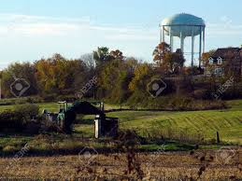
Practice Incentives
NM will collaborate with partners to identify practices that are needed to support the objectives of the source water protection assessments in priority areas
Practices can receive increased payment rates, up to 90% of practice costs
STATES WILL
  Identify local priority areas, and
  Identify practices that address water quality and / or water quantity, and
  Offer producers increased incentives and higher payment rates
Notes:
Tab on PSA to pick 10 EQIP priority practices and tab for SWP practices, no specific limit but S&T has provided some guidance

Slide 44
SWP Practices
All practices that address water quality or water quantity are eligible for source water however the practices below will be eligible for a higher payment rate in Source Water Protection Areas
Irrigation Water Management-449
Residue and Tillage Management, No Till/Strip Till-32
Riparian Forest Buffer-391
Grade Stabilization-410
Diversion-362
Prescribed Grazing-528
Cover Crop-340
Filter Strips-393
Field Border-386
Forage Harvest Management-511
Nutrient Management-590
Pest Management Systems-595
Hedgerow Planting-422
Stream Habitat Improvement and Management-395

Slide 45
NRCS NM- Priority Source Water Watersheds
HUC12 NAME County
120500020105--Cannon Air Force Base--Curry
120500020108---Town of Midway---Curry\Roosevelt
120500020111----12050002011--Curry\Roosevelt
120500020109----City of Clovis--Curry
120500020110-----120500020110--Curry\Roosevelt
120500020202----Blackwater Draw---Curry\Roosevelt
120500020107----Town of Ranchvale---Curry
120500020201-----Pleasure Lake Curry
110800020108----Cimarroncito Creek--Colfax
110800020109----Cimarroncito Creek-Cimarron River-Colfax
110800060102-----Burro Creek----Harding\San Miguel
110800070507-----Las Cuevas Canyon-Tequesquite Creek
110800060104-----Mule Creek-Harding\San Miguel
110800070505---Ladd Lake-Harding
110800070701---Black Lake-Harding
110800070506----Las Cuevas Canyon-Harding
150200060101---Smith Canyon-South Fork Puerco River--McKinley
130202070101----Upper Mitchell Draw--McKinley
130302020105---Shingle Canyon-Mimbres River--Grant

Slide 46
NRCS Will track compliance-
Tracking the 10%- Dedication of 10% FUNDS- both NHQ (GIS) and Locally
  Both financial assistance and technical assistance that addresses water quality and water quantity concerns will be included
  Includes practices implemented through EQIP, CSP and RCPP
  Includes Agricultural Conservation Easement Program (ACEP):
    ALE – Agricultural Land Easements to protect conservation values
    WRE – Wetland Reserve Easements
  Tracking will consider type of system(s) (surface vs. ground water) in determining applicable contracts/practices
Notes:
Baseline SWP coverage will use the EPA SDWIS delineations which are different then the local utility delineations – these will not change over time. Will track the 10% across baseline coverage as Tier 1 data. Will track on submitted local priorities as Tier 2 data. Refined local priorities as Tier 3. important to note here that it includes practices implemented in various programs

Slide 47

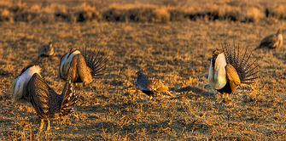

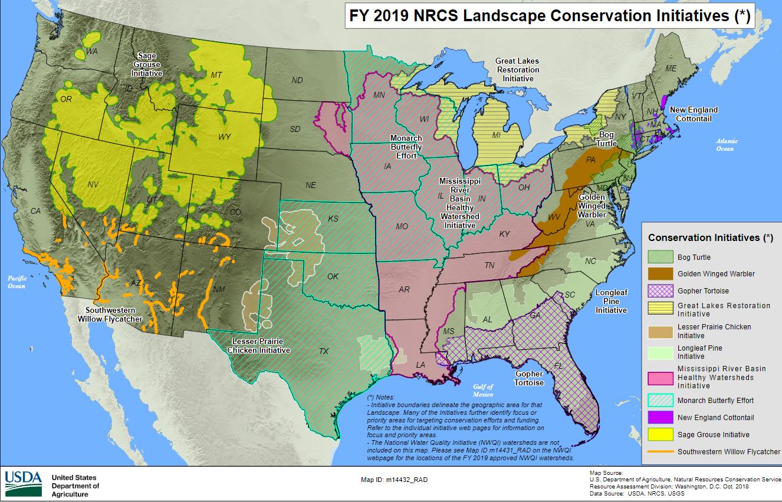
Initiatives
Accelerate benefits of voluntary conservation, such as cleaner water and air, healthier soils and enhanced wildlife habitat.
Ecosystems
Species
Watersheds
Notes:
National Initiatives are for these benefits

Slide 48
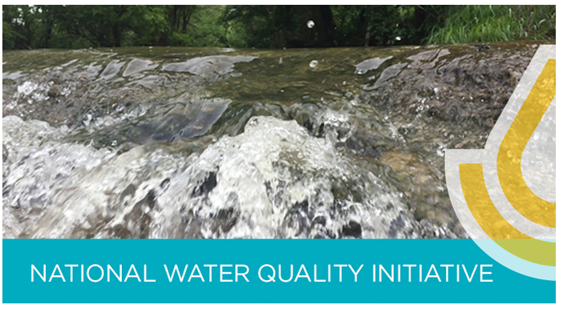
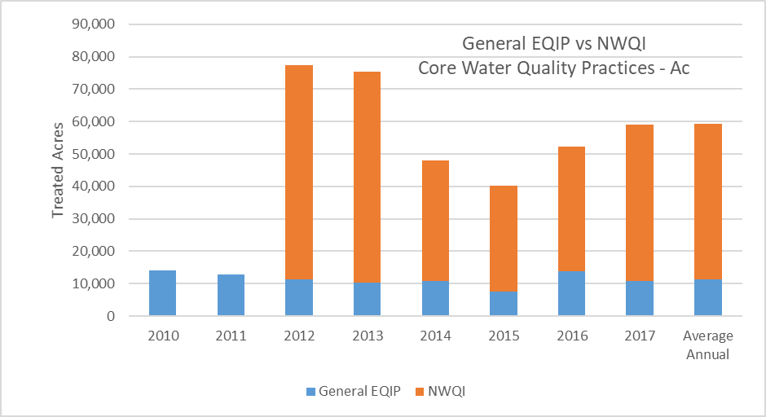
Water Quality Improvements Nationwide
4x
LA- 75% of dairies in Big Creek/ East Big Creek Watersheds assisted
80% reduction in fecal coliform!
NE- Land treatment exceeded 75% in Big Indian Creek
70% reduction in P and sediment loads!
MT- Deep Creek landowners took on hundreds of projects to improve Deep Creek
Re-watered 3.5 miles of stream, reconnected fisheries, increased trout spawn 300%!
303d stream de-listings
Notes:
Outcomes not Outputs

Slide 49


IN SUMMARY
EQIP
  GENERAL
    Up to 10 HPP
  EQIP INCENTIVE
    HPPA, 3 RC, HPP if they align with SW or General
  SOURCE WATER
    SW HPP
Notes:
CONFUSED?

Slide 50
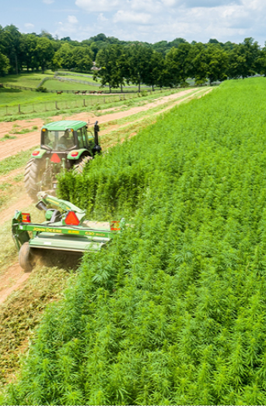
Hemp

Slide 51
HEMP
Regulation:
  USDA’s AMS published an interim rule for the Establishment of a Domestic Hemp Production Program on October 31, 2019 (NB 300-20-5)
    Provides specific details for both a process for the submission of State and Indian tribal plans to USDA and a process for producers in a jurisdiction without an approved plan to apply for authorization directly from AMS.
  AMS will notify FPAC agencies, including NRCS, when it approves a State or Tribal plan, and such approval will be posted to the AMS hemp website at https://www.ams.usda.gov/rules-regulations/hemp/state-and-tribal-plan-review.

Slide 52
HEMP
Production:
  Producers may be authorized to produce hemp by a State or Indian Tribe which has a USDA-approved plan for the domestic production of hemp.
  Producers may seek authorization to produce hemp directly from AMS if they are in a State or territory of an Indian Tribe that authorizes hemp production but such State or Indian Tribe does not have a USDA-approved plan.
  All producers will be required to be licensed through the State, a Tribe, or AMS.

Slide 53
HEMP
Production:
  Hemp producers authorized under an approved plan or through AMS are required to report their hemp crop acreage with FSA, and to provide FSA with specific information regarding field acreage, greenhouse, or indoor square footage of hemp planted.
  FSA Notice CP-755 – provides guidance to FSA offices on obtaining acreage reports from licensed hemp producers and recording it in the Crop Acreage Reporting System (CARS)

Slide 54
HEMP
Program Eligibility:
  Hemp producers will be considered eligible for all NRCS-administered programs if they are authorized to produce hemp by a State or Indian tribe with a USDA-approved hemp production plan or who are authorized directly by AMS.
  Additionally, producers growing industrial hemp in accordance with the research pilot requirements of Section 7606 of the 2014 Farm Bill will also be considered eligible.
    The Section 7606 pilot research exemption will expire one year after publication of the Hemp Rule, and any hemp production by the producer thereafter will need to be in accordance with the Hemp Rule.

Slide 55
HEMP
Program Ineligibility:
  Hemp production without a valid authorization (as previously described)
    This extends to all lands regardless of where the production occurs
    CTA assistance may occur on lands not under production
  The Hemp Rule does not extend to the production of marijuana or other controlled substances; as such NRCS policy remains the same.

Slide 56
HEMP
What NRCS will do if hemp production is discovered:
  Check for proper FSA records
  If proper FSA records exist then proceed with providing program assistance
  If proper FSA records do not exist, confirm whether producer is authorized under research pilot exemption
  If proper records do not exist and cannot be established, and research pilot exemption does not apply, then:
    Applications can be determined ineligible
    Existing contracts will be found in violation and such violations must be handled in accordance with conservation program contract guidance

Slide 57
For more information refer to website below https://www.ams.usda.gov/rules-regulations/hemp

Slide 58
Conservation Planning and Program Contracting Tools Overview/CD & Toolkit/CART
New Mexico
Farm Bill 2018 Rollout
Ana Gomes

Slide 59
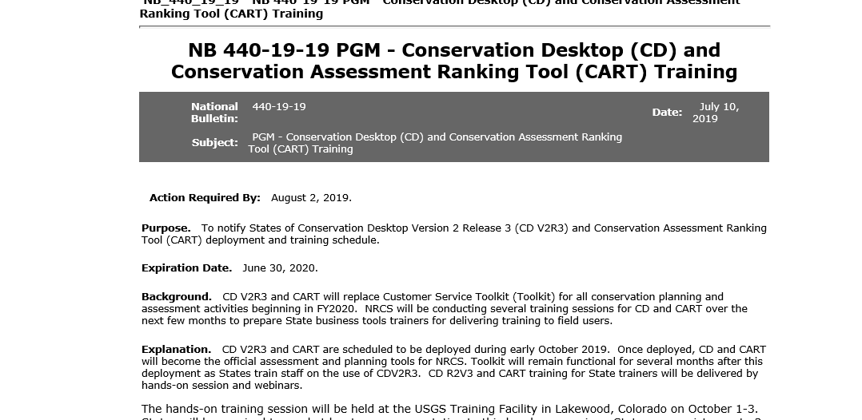
Official Use of CD and CART

Slide 60


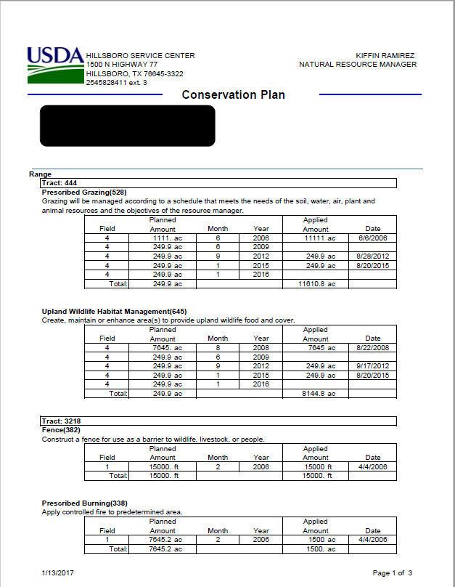
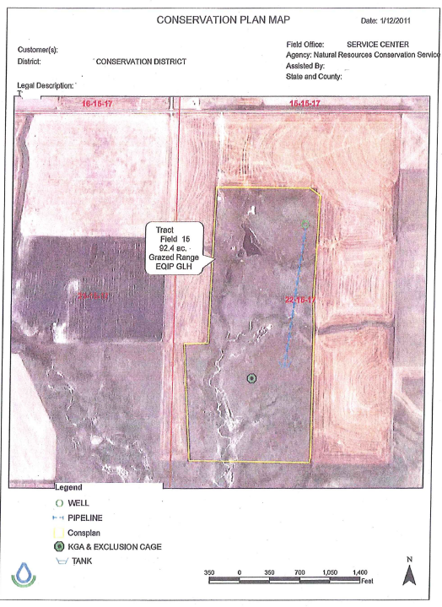
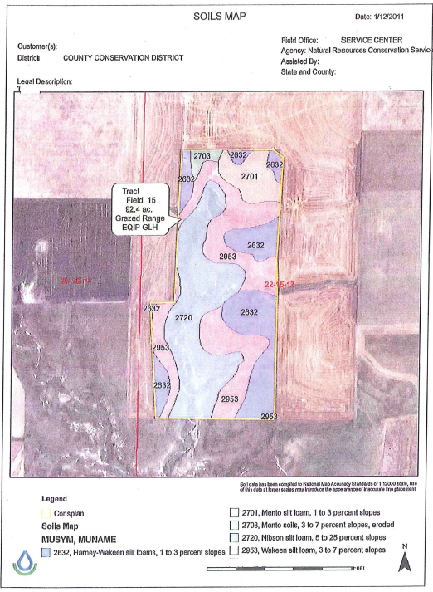

CD/Toolkit
Toolkit Deprecation
States must provide training to field users by February 29, 2020 to allow access to Toolkit to be turned off on March 12 and fully deprecated by March 31, 2020.
Although States have until March to complete training, some aspects of conservation planning and program delivery for FY2020 can only be accomplished using CD and CART.

Slide 61
Field Office – Planning, Assessment and Ranking
Pre-Screen as determined by State
CD
Create Schedule
Identify or create case
Create practice schedule
Add PLUs
CART
Create Assessment
Select RC
Assess Existing Condition including Existing Practices
Select New Practice
Planner Override
Collect Special Concerns Info
CART
Rank Assessment Practices
Identify applicable Ranking Pools
Score Priority Questions
Finalize Score
Estimate Cost by Ranking Pool
Link Application from NEST or ProTracts
ProTracts May Start Application, including eligibility
NEST May Start Application, including eligibility

Slide 62
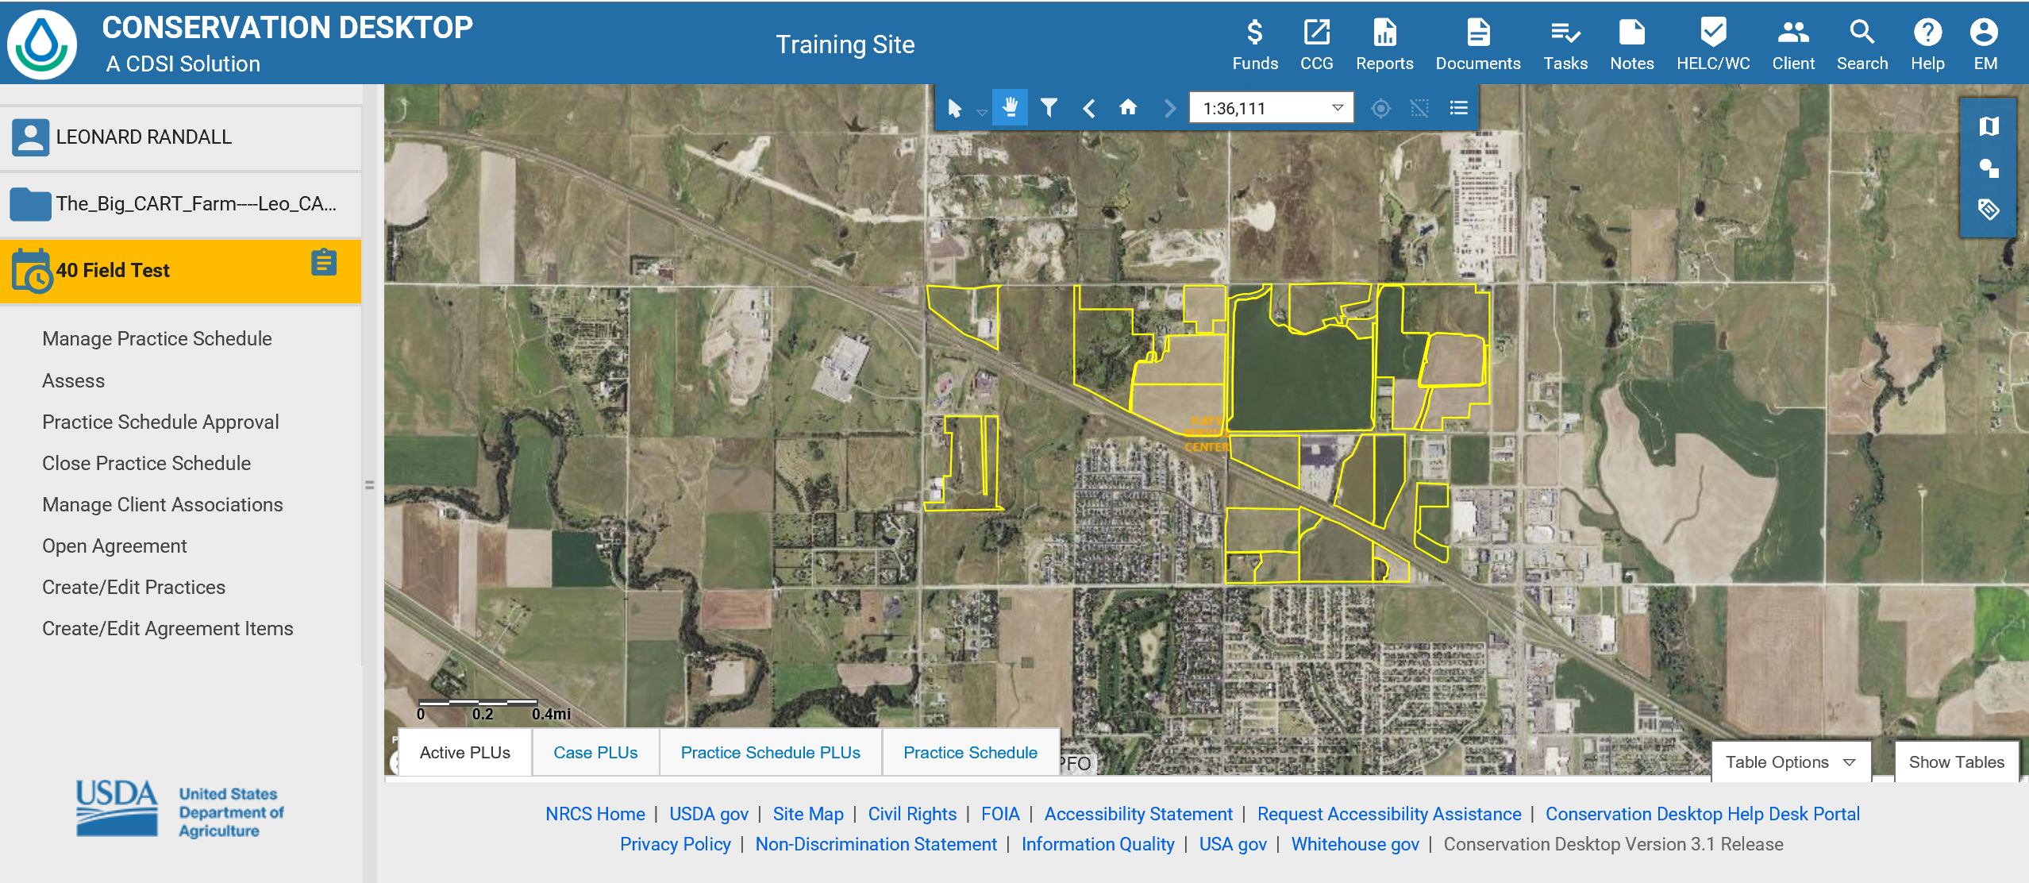
Conservation Desktop
Create Schedule
Identify or create case
Create practice schedule
Add PLUs
keep the Tracts and PLUs matching the FSA CLU boundaries as closely as possible.

Slide 63
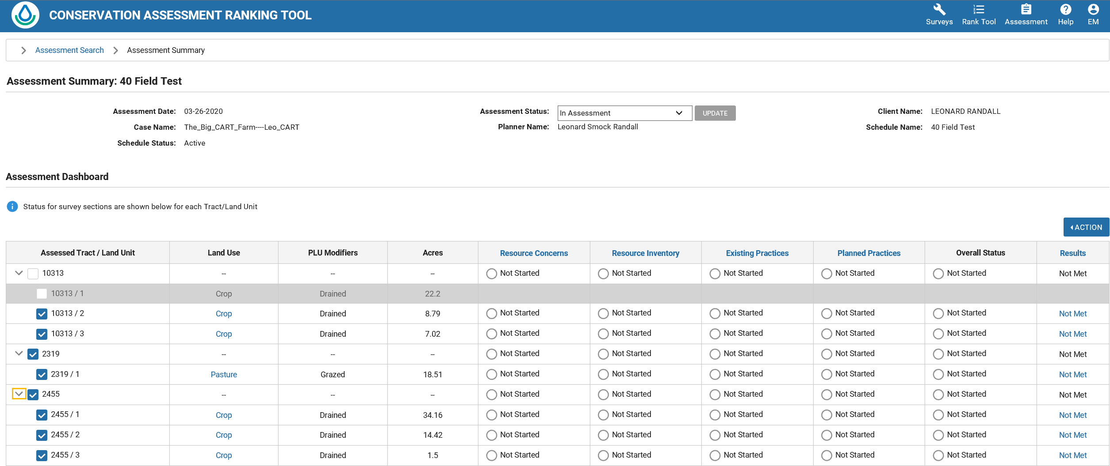
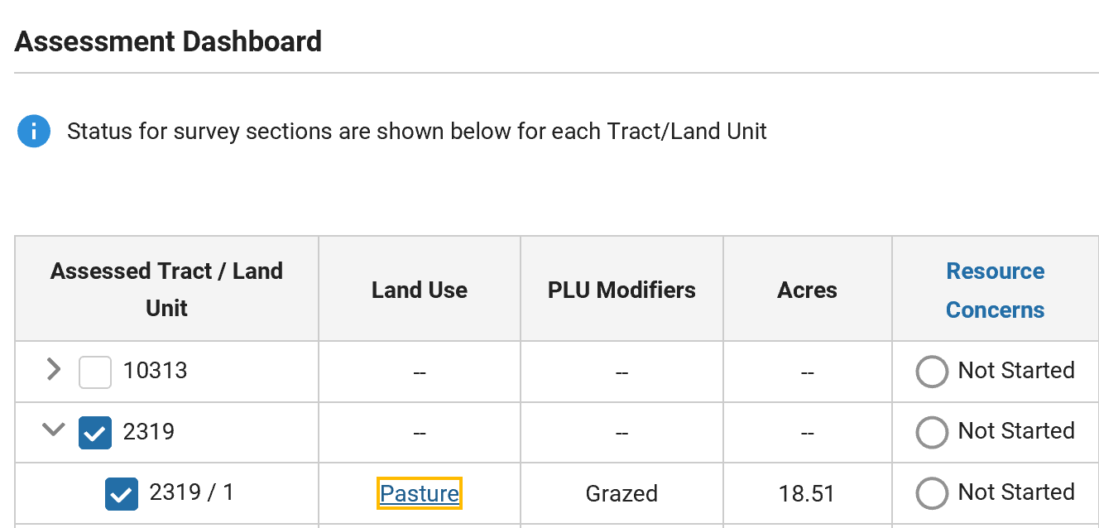
Resource Concerns-Modifiers
Field Office
CART Workflow
Create Assessment
Select Land Use & modifiers
Select RC
Assess Existing Condition including Existing Practices
Select New Practice
Planner Override

Slide 64
Definitions
Practice Schedule- (Conservation plan)The practice schedule includes the schedule of implementation for practices and activities needed to address identified natural resource concerns.
Assessment – the appraisal of a resource concern(s) on a land unit(s) by using geospatial and user evaluations of inventoried resources, analyzed resource data, and evaluated alternatives which leads to a decision to address the resource concern(s)
Ranking Pool Assessment (RPA) – an assessment that has been matched to a ranking pool by CART based on four parameters of land use and modifier, resource concerns, practices, and applicability.
Application – the NRCS application form which includes NRCS-CPA-1200, NRCS-CPA-41a, or AD-1153 forms
Application Number – The number generated in ProTracts or NEST. 1 application may be associated with more than 1 application number. But 2 applications cannot share the same application number.

Slide 65
1. One Schedule/One Program
Multiple Ranking Pools selected at the same time
RPAs
CART created for Eligible Ranking Pools
Applica-tion
RPAs
CART created for Eligible Ranking Pools
Assessment
In CART
RPAs
CART created for Eligible Ranking Pools
Schedule
Created in CD
Application #/Contract
Created in Protracts
Ranking Pool Assessment Score
CART created for Eligible Ranking Pools
Scenario: Planning is completed for all resource concerns before Program Selection
Modification features are not fully developed at this time and may create problems requiring a service ticket or be delayed

Slide 66
Questions?
Kenneth.branch@usda.gov
Ana.gomes@usda.gov
Athena.cholas@usda.gov

