Slide 1

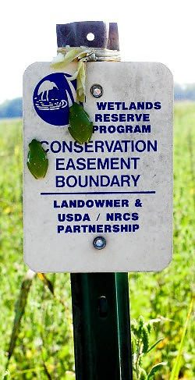

Louisiana Easement Programs Update
State Technical Committee Meeting
May 17, 2022
Tim Landreneau
Notes:
1- Everyone has slides
2- Everyone an application packet which contains the current forms.
Presentation time: 50 min

Slide 2
Louisiana
Easement Programs Update
Agricultural Conservation Easement Program (ACEP)
Wetland Reserve Easement (WRE)
FY 2021 Accomplishments:
Restoration Completed on 38 easements – 13,390 acres
R&E Completed on 12 easements – 3,951 acres
Restoration Started on 23 easements – 8,570 acres
Total restoration activities on 25,911 acres,
22 easement Closed – 2,820
220 eligible applications (373 received)
27 new easement enrollments – 8,281 acres
  Includes 7 WREP enrollments – 4,205 acres
1 30-year easement conversion to Permanent – 98 acres
$26,104,242 obligated
  Acquisition
  Boundary Survey, EDR, Title and Closing Services
  Restoration
Notes:
Wanted to highlight the FY 2018 Accomplishments for ACEP-WRE
Restoration # easements and acres

Slide 3
Louisiana
Easement Programs Update
ACEP – Wetland Reserve Easement (WRE)
1992-2021 WRP / WRE Enrollment Summary:
Enrolled Easements | 1,122 | (41 remaining to close)
Enrolled Acres | 340,081.84 | (14,252 Acres remaining to close)
Closed Easements | 1,081
Closed Acres | 325,829.16
Fully Restored Acres | 314,712.99
Partially Restored Acres | 5,820.57
Pending Restoration Acres | 5,251.46
Notes:
Enrollment status …run through just like partners meeting

Slide 4
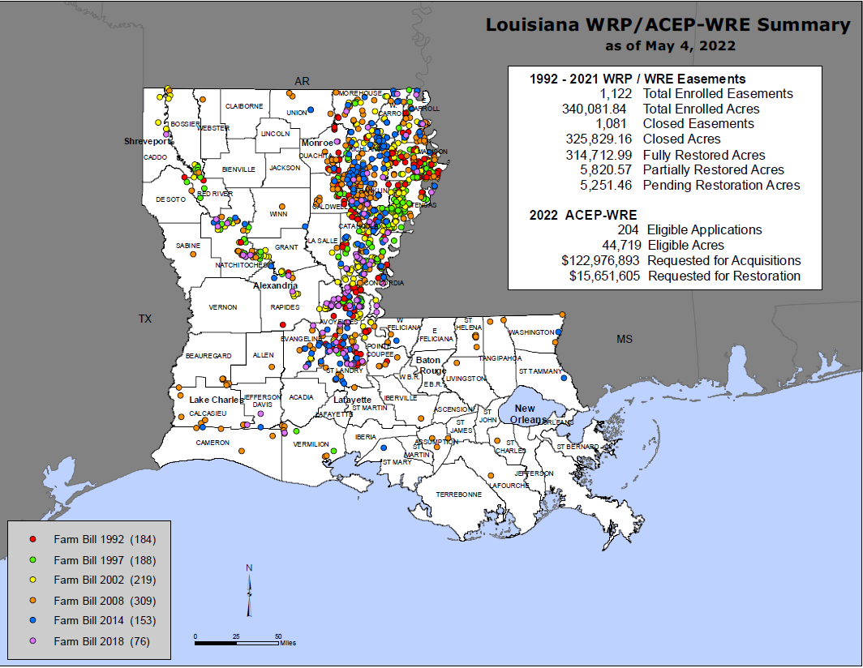
Notes:
In your handouts have a full page copy of this map but the colored dots correspond to the farm Bill year. This map provides an landscape view of the the acquired easements across the state.

Slide 5
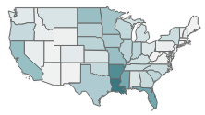
Louisiana
Easement Programs Update
ACEP – Wetland Reserve Easement (WRE)
1992-2021 – LA, AR, MS makes up 28% of the nations WRP/WRE enrolled acres with a combined 812,452 acres
  LA – 340,082 acres – 1st in the nation
  AR – 277,239 acres – 2nd in the nation
  MS – 195,131 acres – 4th in the nation
Notes:
This map combine's all prior year farm bills from 92-2018 again in dark blue and teal (LA/MISS/ARK) alone made up 27% of the US enrolled WRP/WRE easements with a total acreage of 767,955 acres.

Slide 6
Louisiana
Easement Programs Update
ACEP – Wetland Reserve Easement (WRE)
FY 2022 Current Status:
ACEP-WRE FA Allocation:
  WRE General
    $18,556,460
      $15,555,960 – New Enrollments
      $3,000,500 – Stewardship
  WRE – Tri-State WREP
    $5,216,250
  WRE – Batture WREP
    $2,152,647
  $25,925,357 Total WRE FA Allocation
Notes:
LA received its FY 19 funding allocation and we are moving forward with tentative selections and enrollments
1- received 4.6 M in funds which can only be used on prior or existing easements
2-received 12.5 M to use on new enrollments for 2019
3- requested an additional 9.4 M for FY 19
4- Brings us to a total of 17.2M received for both 14 and 18 Farm bill
5-received 5M in WRP funds and this is for continued restoration and enhancements on prior year WRP easements.

Slide 7
Louisiana
Easement Programs Update
ACEP – Wetland Reserve Easement (WRE)
FY 2022 Current Status:
Notes:
LA received its FY 19 funding allocation and we are moving forward with tentative selections and enrollments
1- received 4.6 M in funds which can only be used on prior or existing easements
2-received 12.5 M to use on new enrollments for 2019
3- requested an additional 9.4 M for FY 19
4- Brings us to a total of 17.2M received for both 14 and 18 Farm bill
5-received 5M in WRP funds and this is for continued restoration and enhancements on prior year WRP easements.

Slide 8
Louisiana
Easement Programs Update
ACEP – Wetland Reserve Easement (WRE)
FY 2022 Application Screening/Ranking Criteria:
Enables NRCS to prioritize enrollment offers by determining applications that offer the most merit for enrollment.
Revised in FY2014 through a tri-state collaboration and in consultation with FWS, LDWF, and the State Technical Committee.
Minor revisions in FY2019 to add priority to applications for Permanent easements and applications with establishment of habitat cover on more than 50% of the offer area.
FY2021 – Minor revision to separate Active CRP from Ag Land under hydrology weighting
Notes:
Application received are ranked in order to prioritized applications based on the most merit for enrollment in the program.
Reminder in 2014 a substantial revision was completed for ranking criteria.
In 2019 a minor revision was completed to add criteria into the ranking for permeat easements and Habitat cover .

Slide 9
Louisiana
Easement Programs Update
ACEP – Wetland Reserve Easement (WRE)
FY 2022 Application Ranking Criteria:
Environmental Benefit Considerations:
Location Significance – Proximity
Wildlife Habitat – T&E Priority Habitat Zones
Water Quality – Surface Water Filtering
  Filter – Sump
  Site Location – 305b Report
Hydrology Restoration Potential
Habitat Diversity
Easement Duration
Economic Consideration:
Operation and Maintenance
Cost-Benefit Comparison
Notes:
1-A copy of the ranking from is in the hand out for review
2-The chart here shows the weihts by category with the most wtight is the largest factors.

Slide 10
Louisiana
Easement Programs Update
ACEP – Wetland Reserve Easement (WRE)
FY 2022 Geographic Area Rate Cap (GARC):
Each year, NRCS, in consultation with the State Technical Committee, must establish a process to determine easement compensation rates for enrollment into ACEP-WRE.
For FY2022, NRCS conducted an Area Wide Market Analysis (AWMA) to determine fair market value for five geographic zones. For each designated zone, a GARC was calculated to reflect the value determined to be fair compensation for the rights being acquired through a ACEP-WRE easement.
Notes:
Annually Consult with the State Technical Committee to establish easement compensation rates.
NRCS annually contracts the Market Analysis to evaluate the fair market values for the 5 geographic zones in the Louisiana. The AWMA forms the basis of the GARC (Geograpchi Rate Cap) for easement values
Currently we are in the process of contracting the 2020 AWMA.

Slide 11
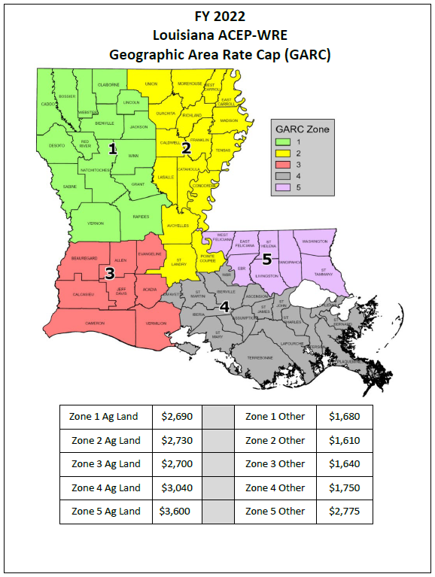
Notes:
In your handouts there is copy of the FY 19 easement rates for each area in LA.

Slide 12




Slide 13
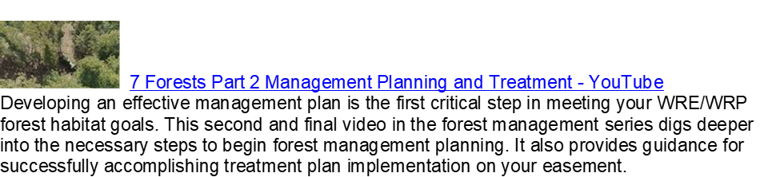

Slide 14


Slide 15
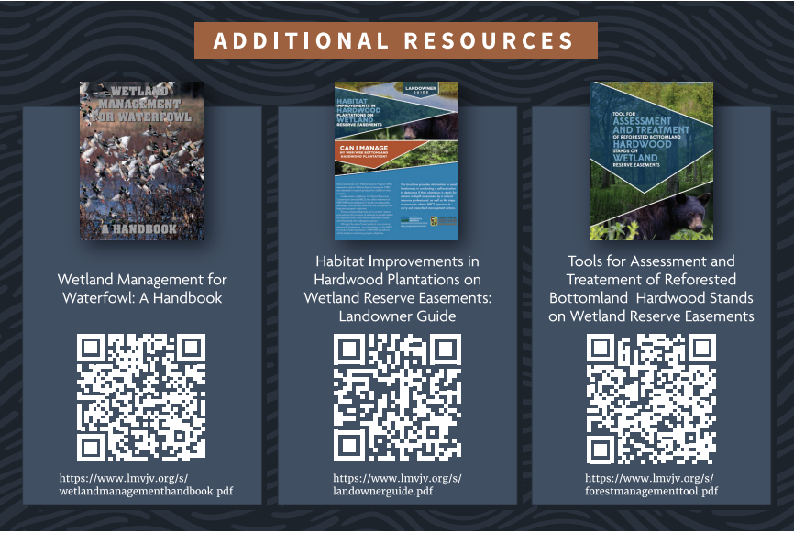

Slide 16



Slide 17

The U.S. Department of Agriculture (USDA) prohibits discrimination in all its programs and activities on the basis of race, color, national origin, age, disability, and where applicable, sex, marital status, familial status, parental status, religion, sexual orientation, genetic information, political beliefs, reprisal, or because all or a part of an individual's income is derived from any public assistance program (not all prohibited bases apply to all programs). Persons with disabilities who require alternative means for communication of program information (Braille, large print, audiotape, etc.) should contact USDA's TARGET Center at (202) 720-2600 (voice and TDD). To file a complaint of discrimination write to USDA, Director, Office of Civil Rights, 1400 Independence Avenue, S.W., Washington, D.C. 20250-9410 or call (800) 795-3272 (voice) or (202) 720-6382 (TDD).
USDA is an equal opportunity provider and employer.

